Slide 1
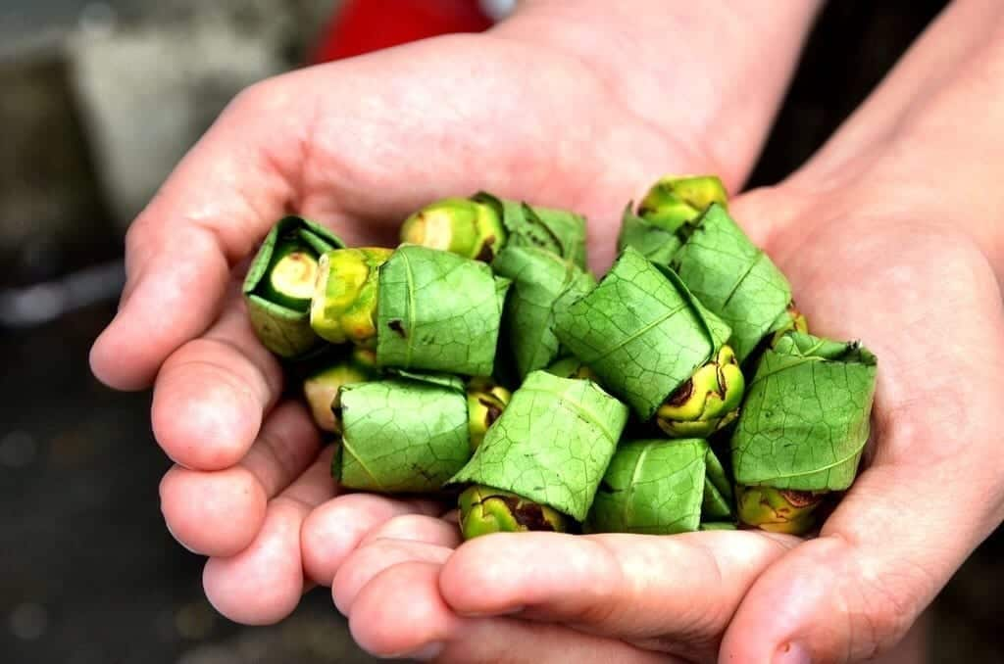
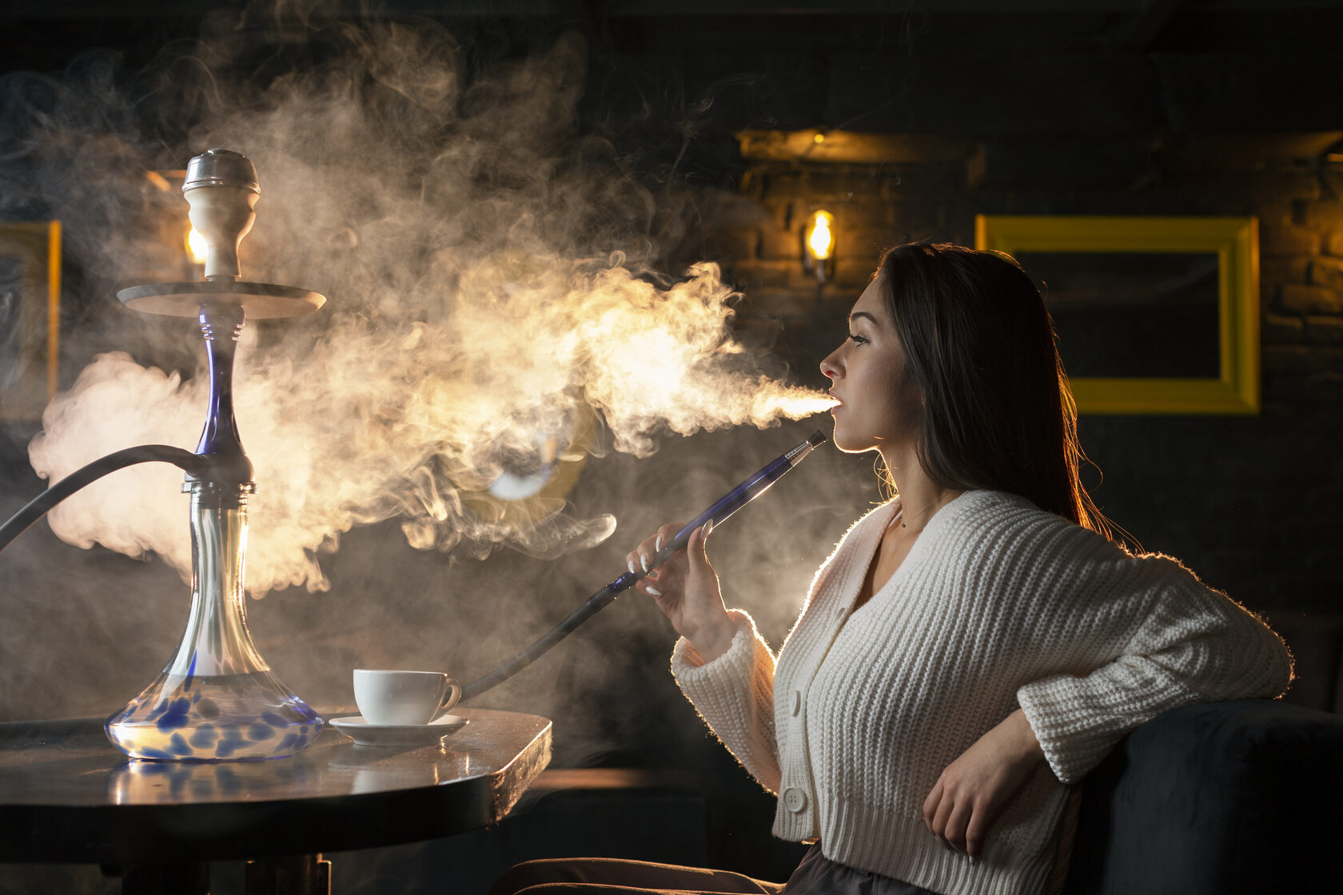
Conclusion: Smokeless tobacco
Betel Nut/Areca Nut/Paan/Guthka:
South Asian and some Southeast Asian communities (incl. Thai)
Paan/betel quid = mixture of betel/areca nut, herbs, spices, slaked lime, and tobacco wrapped in betel leaf. This is chewed and held in the mouth.
Chewing betel nut/quid alone without tobacco is also increased risk of oral cancer (Warnakulasuriya and Chen, 2022)
A sign of hospitality and respect in offering to guests. Commonly consumed after meals to aid with digestion. Also used in religious ceremonies.
Increased risk of developing mouth and oesophageal cancer due to chewing and ingesting the tobacco rather than inhaling
Shisha
Contains nicotine, tar, carbon monoxide and heavy metals such as arsenic and lead.
A Shisha session of 20-80 minutes contains the same amount of smoke as a cigarette smoker smoking 100 cigarettes. (BHF)
Warnakulasuriya S, Chen THH. Areca Nut and Oral Cancer: Evidence from Studies Conducted in Humans. J Dent Res. 2022 Sep;101(10):1139-1146. doi: 10.1177/00220345221092751. Epub 2022 Apr 22. PMID: 35459408; PMCID: PMC9397398.
Notes:
(https://fisd.oxfordshire.gov.uk/kb5/oxfordshire/directory/advice.page?id=SdkHdyHXjQs )

Slide 2
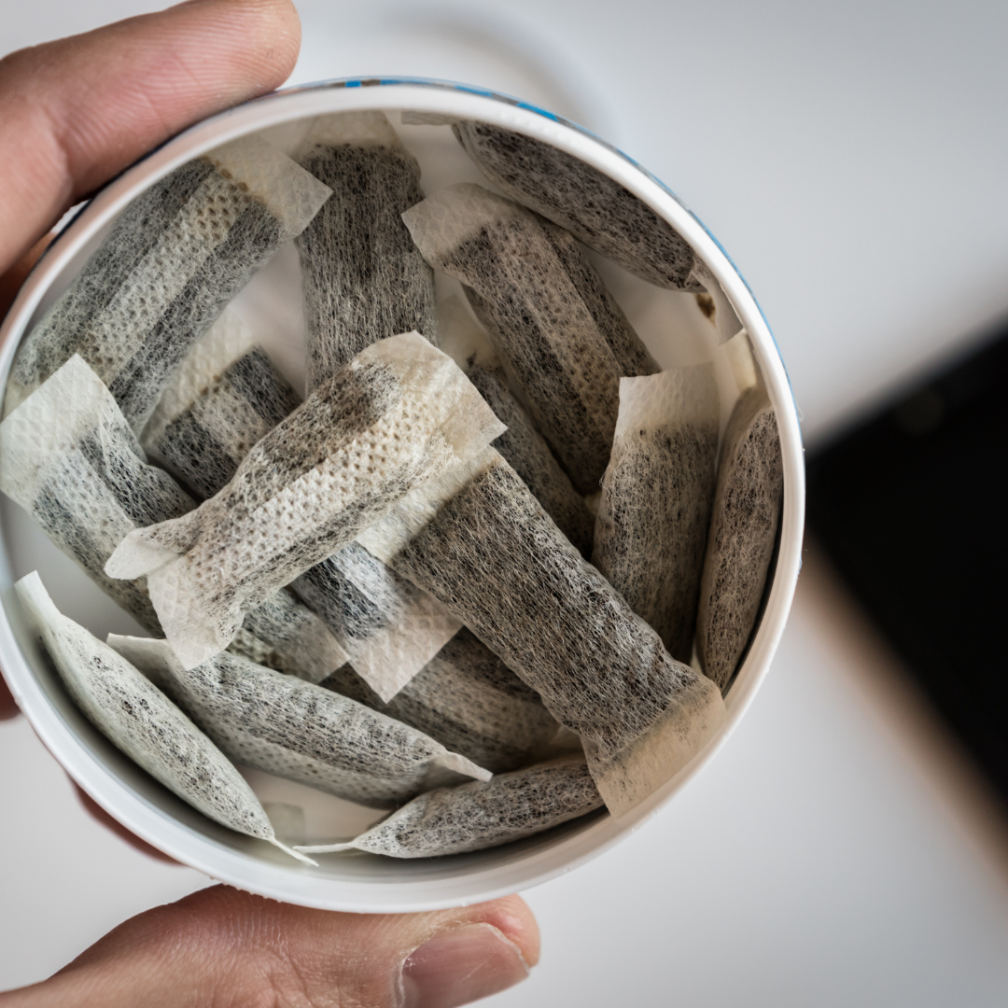
Conclusion: Smokeless tobacco
Snus
Powdered tobacco leaves in a pouch
Sweden and Norway (illegal in rest of Europe)
Increased risk of cancer of the esophagus, pancreas, stomach and rectum
Snus is not to be confused with nicotine pouches which do not contain tobacco
Valen H, Becher R, Vist GE, et al. A systematic review of cancer risk among users of smokeless tobacco (Swedish snus) exclusively, compared with no use of tobacco. Int J Cancer. 2023;153(12):1942-1953. doi:10.1002/ijc.34643
Notes:
https://ashscotland.org.uk/briefing/nicotine-pouches/

Slide 3
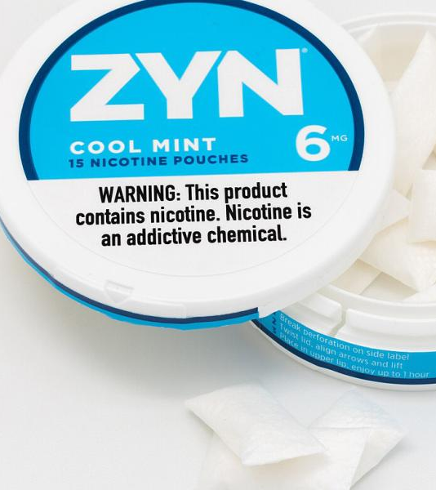
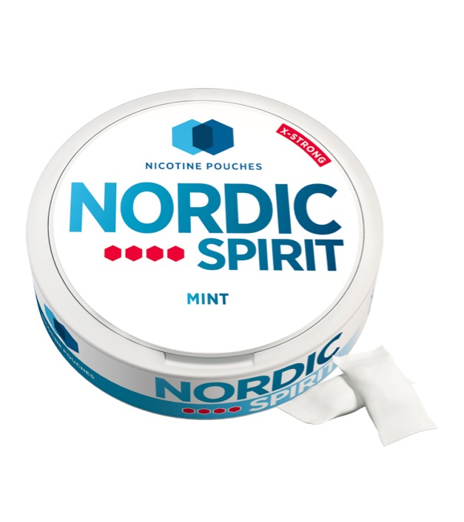
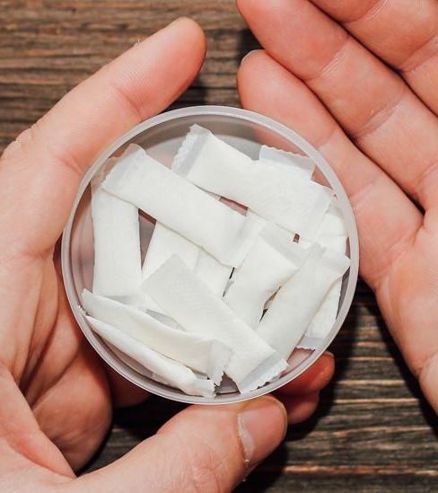
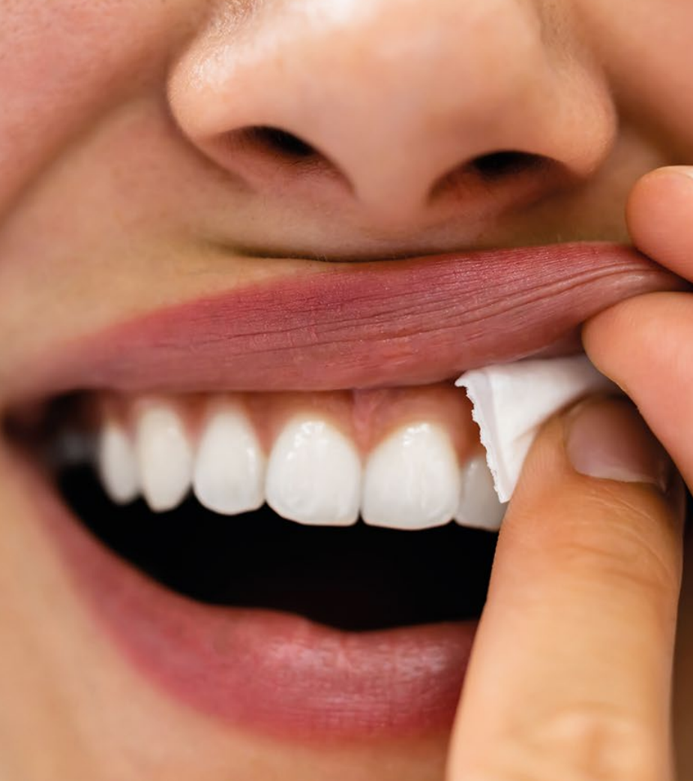
Conclusion: Nicotine pouches
Sold since 2019
Nicotine pouches do not contain tobacco; water, microcrystalline cellulose, flavourings
Another option in tobacco harm reduction and smoking cessation
Popularised with sport and younger communities
No carcinogenic risk, only addictive risk and possible oral soreness/local recession (no evidence as of yet)
M. Jackson, J., Weke, A. & Holliday, R. Nicotine pouches: a review for the dental team. Br Dent J 235, 643–646 (2023). https://doi.org/10.1038/s41415-023-6383-7

